Slide 1
NEIL GOGTE INSTITUTE OF TECHNOLOGY
DEPARTMENT OF CSE (ARTIFICIAL INTELLIGENCE & MACHINE LEARNING)
Interactive MIDI Musical Keyboard: Simplified Music Creation using Python
Presented By:
A Manidhar (2453-21-748-038)
Sri Chandra Vardhan (2453-21-748-057) T Vishnu Vandhan (2453-21-748-058)
Under the Guidance
Of
Mrs. M Deepika
Assistant Professor

Slide 2
INTRODUCTION
BRIEF OVERVIEW:
This project delivers an interactive virtual keyboard app for Android, designed to make music creation easy and accessible. It offers a realistic piano-style interface and supports 128 General MIDI instruments, enabling users to explore various musical styles..
Built with Java backend and React Native frontend, the app ensures low-latency sound, real-time response, and future cross-platform support. Features like volume control, octave shifting, and visual key highlights enhance usability.
Built using Android Studio, the app integrates a Java backend for performance and a React Native frontend for responsive, cross-platform support. It ensures low-latency sound, real-time key response, and additional features like volume control, octave shifting, and visual key highlights.
By combining portability, versatility, and affordability, this app empowers users to create and experiment with music—anytime, anywhere.

Slide 3
PROBLEM STATEMENT:
Most digital music tools are complex, costly, or require external MIDI hardware, making them hard to use for beginners and casual users. To solve this, we developed a simple and portable Android-based virtual keyboard app that offers a realistic piano experience directly on mobile devices..
The app uses a Java backend and React Native frontend to ensure smooth performance and a responsive interface. It maps each key to musical notes and supports 128 General MIDI instruments, allowing users to explore various sounds and styles..
Designed to be accessible and easy to use, the app requires no extra hardware or prior MIDI knowledge—making it a creative tool for users of all skill levels.

Slide 4
OBJECTIVES
1. User-Friendly Interface:
2. Real-Time Sound Playback:
3. Multiple Instrument Support:
4. Cross-Platform Potential: .
5. Customization Options:
6. Robust Error Handling:
7. Learning Assistance:
8. Recording & Sharing:
9. Future Expansion Ready:

Slide 5
LITERATURE SURVEY
PRIOR WORK OR RELATED STUDIES
Study / Work | Focus Area | Limitations / Gaps | How Proposed System Addresses It
Smith & Lee (2021) | AI in sound synthesis and adaptive user interaction | Lacks mobile-focused implementation and real-time responsiveness | Integrates AI features with real-time, mobile-friendly sound synthesis and feedback
Johnson et al. (2019) | Interactive music learning tools | Missing intuitive key-note mapping and seamless MIDI integration on mobile | Provides intuitive UI, key-to-note mapping, and mobile MIDI support
Garcia (2020) | Blockchain for digital rights management | Focused on ownership and rights—not user-level music creation | Focuses on creative tools and user interaction, not on DRM or blockchain
Kim & Park (2022) | Blockchain in music applications | Unrelated to real-time music creation or instrument simulation | Targets real-time creation, feedback, and interactive music composition
General Market Tools | Virtual instruments on desktop/mobile | High latency, poor sound quality, complex UI | Delivers low-latency, high-quality sound, and user-friendly design
Proposed System (This Project) | Integrated mobile MIDI keyboard with AI & cross-platform features | N/A – Designed to fill existing gaps | Combines AI, cross-platform support, real-time audio, and ease of use—no extra hardware needed

Slide 6
LIMITATIONS IN EXISTING SYSTEMS
Limited Customizability – Few options to personalize sounds or settings.
Complexity for Beginners – Many tools are difficult to use without prior knowledge.
High Cost – Advanced features often require costly licenses or subscriptions.
Platform Dependency – Tools may not work across all devices or operating systems.
Hardware & Online Dependence – Require powerful devices or constant internet access.

Slide 7
TECHNOLOGIES USED EARLIER
Study / Tool | Technologies/Methods Used | Limitations Identified
Virtual MIDI Piano Keyboard (VMPK) | Desktop MIDI, C++/Qt framework | Lacks mobile support, complex setup for beginners.
Online Web MIDI Synthesizers | WebMIDI API, JavaScript | Requires stable internet, limited sound customization, latency issues.
Smith and Lee (2021) | AI, Machine Learning for sound synthesis | No mobile app focus, limited real-time sound processing on portable devices.
Johnson et al. (2019) | Real-time feedback systems, educational frameworks | No seamless MIDI integration; lacks portability and intuitive interface for mobile.
Garcia (2020) | Blockchain for Digital Rights Management | Focused on content security, not on improving user music creation experience.
Nguyen and Patel (2023) | IoT, AI for interface optimization | No real-time sound processing or MIDI support; focused more on usability analytics.

Slide 8
PROPOSED SYSTEM
OUR APPROACH
The proposed system is a virtual MIDI musical keyboard that simplifies digital music creation by eliminating the need for physical instruments or MIDI controllers. Designed to be accessible for beginners and hobbyists, it offers a realistic piano-like interface with keys mapped to musical notes, playable via keyboard, mouse, or touchscreen.
The app includes features like 128 General MIDI instrument sounds, real-time audio playback, visual feedback, volume and octave control, and basic recording and playback. It supports multiple platforms such as desktop and Android, with future expansion to iOS and web.
Future plans include AI-based melody suggestions, performance feedback, and collaborative tools for real-time remote music sessions—making this a complete and user-friendly platform for digital music creation and learning.

Slide 9
KEY INNOVATIONS
Mobile Accessibility:
Beginner-Friendly Interface:
128 General MIDI Instrument Support:
Low-Latency Real-Time Playback:
Customizable Features:
Error Handling and Stability:

Slide 10
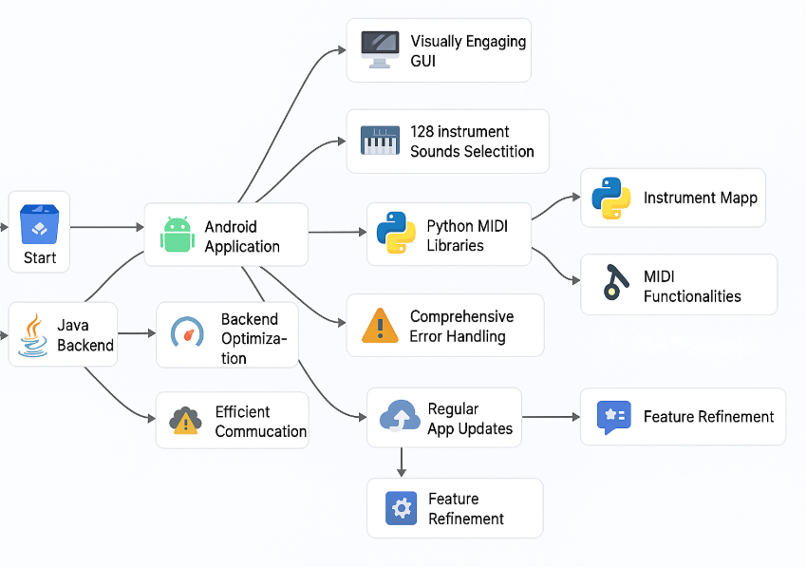
SYSTEM ARCHITECTURE

Slide 11
TOOLS, ALGORITHMS, FRAMEWORKS USED
Category | Name/Technology | Purpose/Usage
Development Platform | Android Studio | To build and test the Android mobile application.
Programming Languages | Java (Backend) Python (mido, pygame.midi) | - Logic handling, performance optimization, API services. -MIDI event processing, instrument mapping, sound output.
Frontend Framework | React Native (Proposed for Future) | Cross-platform mobile app development (Android/iOS).
Sound Processing | MIDI Protocol, mido library | Generating MIDI signals for real-time audio playback.
Input Handling | pynput (Python) | Detecting and processing key presses from the user.
API Development | FastAPI (Python) | RESTful API for managing MIDI commands and playback.
Error Handling | Exception Handling (Java & Python) | Managing invalid inputs, multiple key presses, errors.
Version Control | Git/GitHub | Code management and collaborative development.
Testing Tools | Manual Testing (Test Cases) | Verifying feature functionality and system stability.

Slide 12
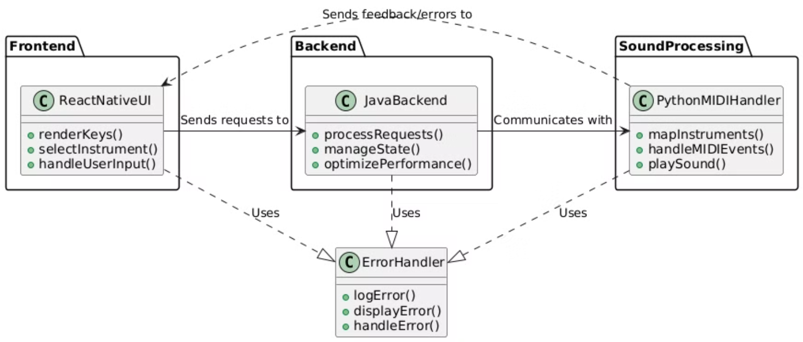
DESIGN
Fig 1: CLASS DIAGRAM

Slide 13
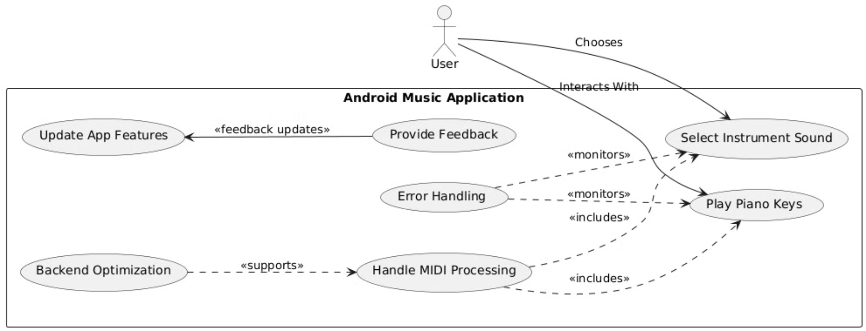
Fig 2: USE CASE DIAGRAM

Slide 14
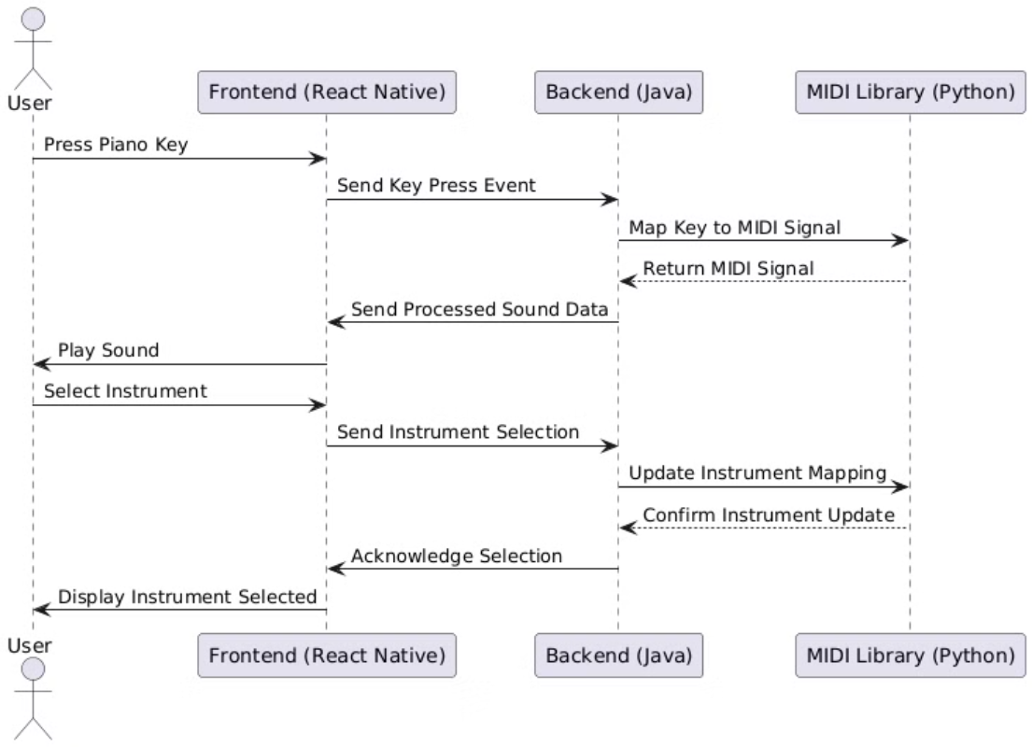
Fig 3: SEQUENCE DIAGRAM

Slide 15
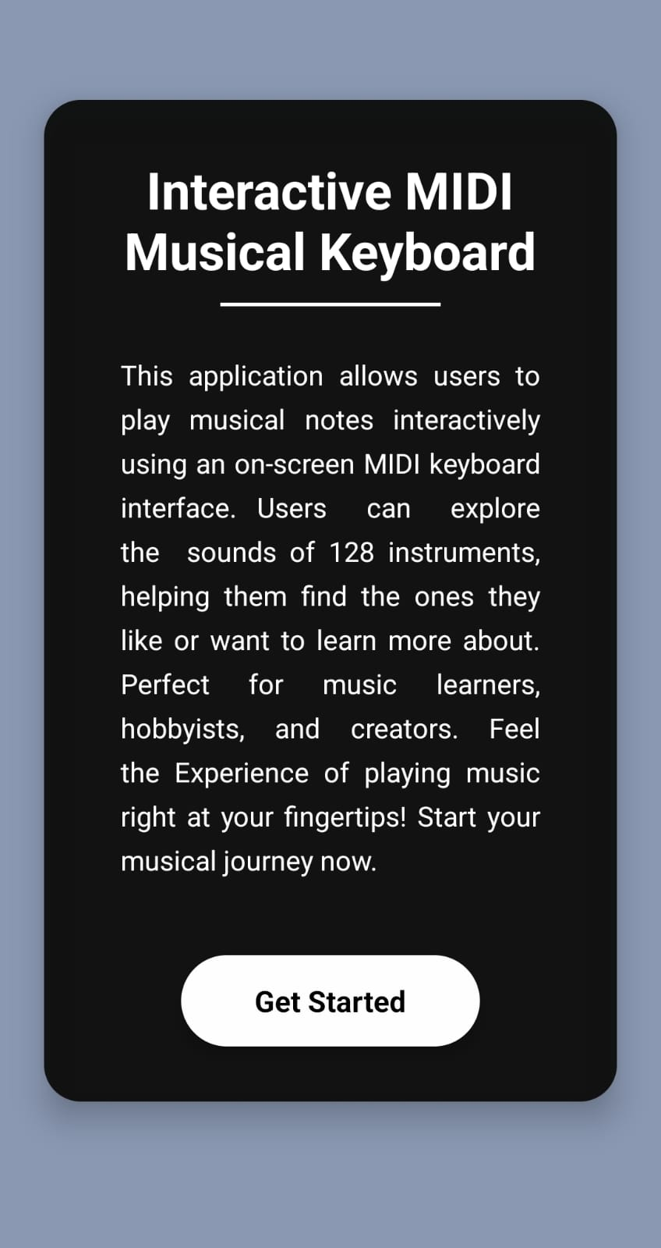
RESULTS
Fig 4: MAIN VIEW

Slide 16
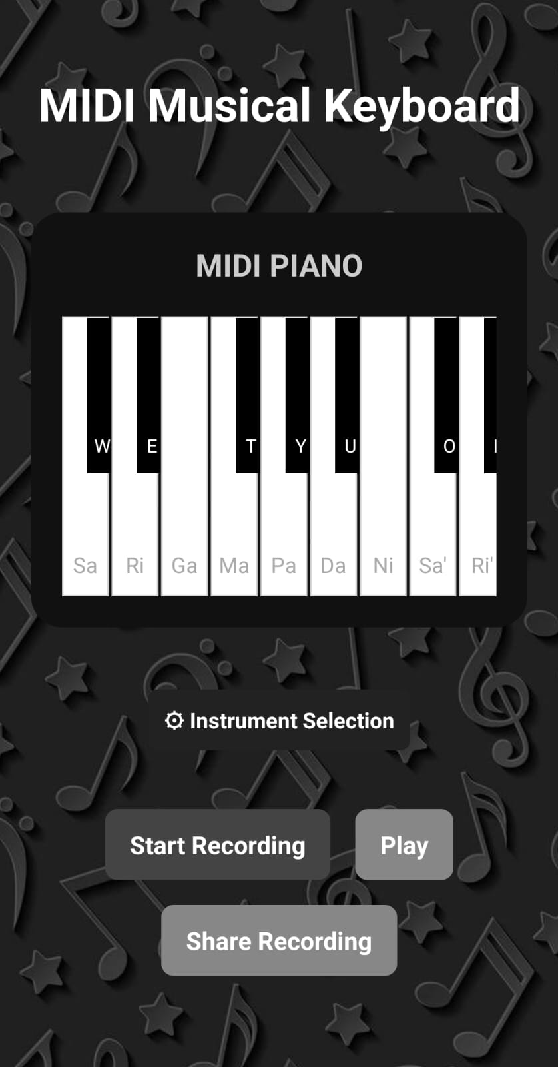
RESULTS
Fig 5: KEYBOARD VIEW

Slide 17
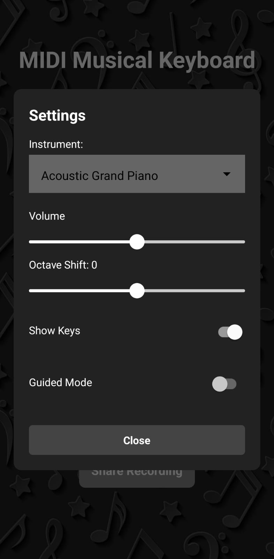
RESULTS
Fig 6: INSTRUMENT SELECTION VIEW

Slide 18
CONCLUSION AND FUTURE SCOPE
CONCLUSION
The Interactive MIDI Musical Keyboard is a beginner-friendly Android app that enables users to create music without complex tools or external hardware. Its simple, portable design makes it ideal for students, hobbyists, and anyone interested in music creation.
The app combines Python MIDI libraries for sound, a Java backend for performance, and a React Native frontend for a smooth, responsive interface. Users can select from 128 MIDI instruments, adjust volume and octaves, and get real-time feedback.
Designed for future growth, the system supports expansion into AI-assisted features, cloud storage, and collaborative music sessions. It offers a versatile platform for learning, composing, and exploring music easily and affordably.

Slide 19
FUTURE SCOPE
Cross-Platform Deployment
Advanced Sound Engine
MIDI Device Integration
Recording & Export Features
AI-Powered Assistance

Slide 20
CURRENT LIMITATIONS
Limited Key Range
Basic Features Only
Platform Restriction .
Recording Limitations

Slide 21
Add realistic soundfonts and audio effects (reverb, echo, EQ) for studio-like quality.
POSSIBLE IMPROVEMENTS/ EXTENSIONS
Cross-Platform Support
Enhanced Sound Engine
Full MIDI Integration .
Recording & Export
UI Customization
AI Assistance
Collaborative Features.

Slide 22
REFRENCES
[1] C. M. Belinda M J et al., ”Music Note Series Precipitation using Two Stacked Deep Long Short Term Memory Model,” 2022 Second Interna tional Conference on Advances in Electrical, Computing, Communication and Sustainable Technologies (ICAECT), Bhilai, India, 2022, pp. 1-5, doi: 10.1109/ICAECT54875.2022.9807884.
[2] G. A. Restrepo and J. A. G. Herrera, ”Seat & Play: A vir tual learning environment for harmony,” 2011 6th Colombian Com puting Congress (CCC), Manizales, Colombia, 2011, pp. 1-5, doi: 10.1109/COLOMCC.2011.5936335.
[3] G. G. N. S and V. V. P. D, ”Generating Creative Classical Music by Learning and Combining Existing Styles,” 2023 4th Int. Conf. on Communication, Computing and Industry 6.0 (C216), Bangalore, India, 2023, pp. 1-7, doi: 10.1109/C2I659362.2023.10431294.
[4] G. Lassauniere, E. Tewkesbury, D. A. Sanders, J. Marchant and A. Close, ”A new music technology system to teach music,” Proc. 25th EUROMICRO Conf., Milan, Italy, 1999, pp. 1-7, doi: 10.1109/EUR MIC.1999.784400.
[5] Ji, ”Sakura: A VR musical exploration game with MIDI keyboard in Japanese Zen environment,” 2020 IEEE Conf. on Games (CoG), Osaka, Japan, 2020, pp. 620-621, doi: 10.1109/CoG47356.2020.9231808.
[6] J. D´ ıaz-Estrada and A. Camarena-Ibarrola, ”Automatic evaluation of music students from MIDI data,” 2016 IEEE Int. Autumn Meeting on Power, Electronics and Computing (ROPEC), Ixtapa, Mexico, 2016, pp. 1-6, doi: 10.1109/ROPEC.2016.7830597
[7] M. Chaudhry, S. Kumar and S. Q. Ganie, ”Music Recommendation System through Hand Gestures and Facial Emotions,” 2023 6th Int. Conf. on Information Systems and Computer Networks (ISCON), Mathura, India, 2023, pp. 1-7, doi: 10.1109/ISCON57294.2023.10112159.
[8] S. Conan, O. Derrien, M. Aramaki, S. Ystad and R. Kronland-Martinet, ”A Synthesis Model With Intuitive Control Capabilities for Rolling Sounds,” IEEE/ACM Trans. Audio, Speech, and Lang. Process., vol. 22, no. 8, pp. 1260-1273, Aug. 2014, doi: 10.1109/TASLP.2014.2327297.
[9] T. Tanaka and Y. Tagami, ”Automatic MIDI data making from music WAVE data performed by 2 instruments using blind signal separation,” Proc. 41st SICE Annu. Conf., Osaka, Japan, 2002, pp. 451-456 vol.1, doi: 10.1109/SICE.2002.1195442

Slide 23
WEBSITES, TOOLS, LIBRARIES
Category | Name / Link | Purpose / Description
Development IDE | Android Studio | Development and testing of the Android application.
Backend | Java (JDK 8+) | Backend logic, API handling, and performance optimization.
Frontend | React Native | Cross-platform UI development (proposed for expansion).
Python Libraries | mido, pygame.midi | MIDI signal processing, instrument mapping, sound output.
Input Handling | pynput (Python) | Detecting and processing user keyboard input.
Web MIDI References | https://webmidi.org/ | Reference for WebMIDI API in web-based MIDI applications (future scope).
API Framework | FastAPI (Python) | Creating RESTful API endpoints for MIDI communication.
Version Control | Git / GitHub | Code management and collaborative development.
Testing Tools | Manual Testing | Verifying app functionality through defined test cases.
MIDI Standards Reference | https://www.midi.org/ | General MIDI instrument standards and specifications.

Slide 24
IEEE CONFERENCE PAPER
Click Here to view Paper

Slide 25
ANY
QUESTIONS?

Slide 26
THANK YOU

